Slide 1
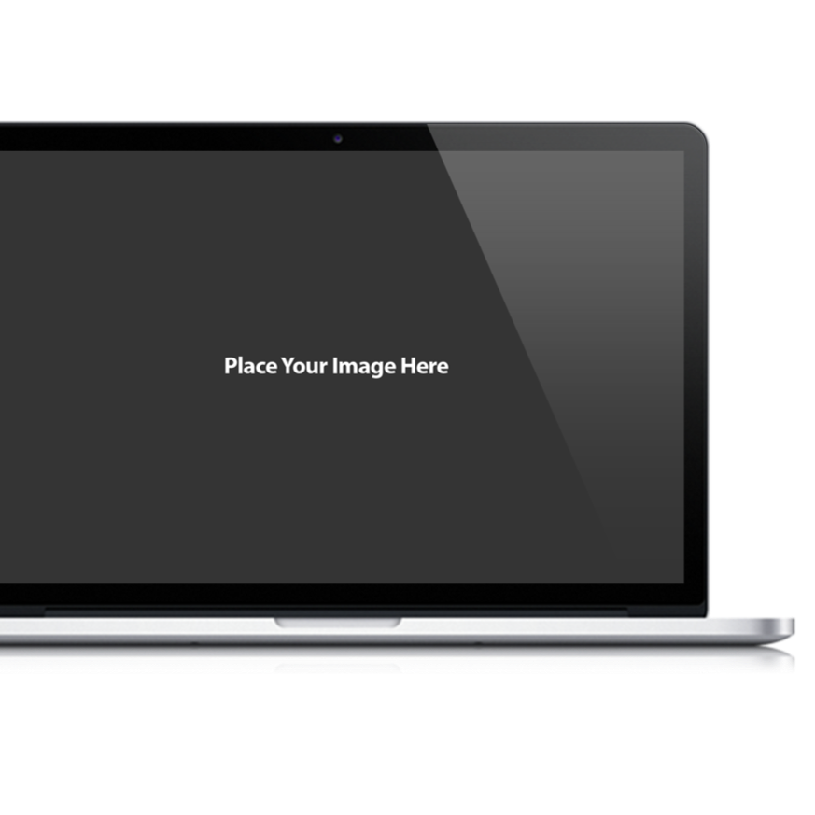
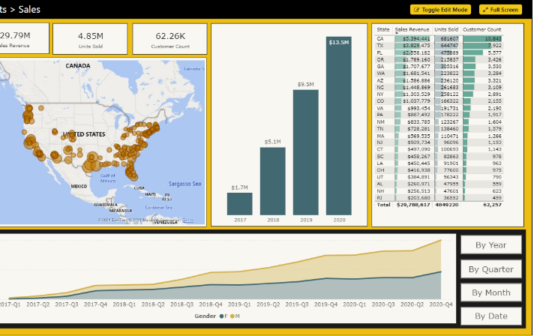
Microsoft Power BI
PBICAT
Building Multi-language Reports in Power BI
Ted Pattison Power BI Customer Advisory Team (PBICAT)

Slide 2
Agenda
Introduction to Multi-language Report Design
Programming Translations with TOM
Designing Workflows to Manage Translations
Multi-language Report Design with Translations
Embedding Reports with Specific Locales
Designing for Content Translation

Slide 3
Localizing PBIX Projects Overview
PBIX Localization only supported for data model
Report designer has no knowledge of dataset localization support
Localization only supported for names of table and fields
This technique not used to localize content – only schema metadata
Requires tricks in the report designer to localize string content on report
PBIX File
Report Layout
no knowledge of localization
Dataset Definition
can be localized

Slide 4
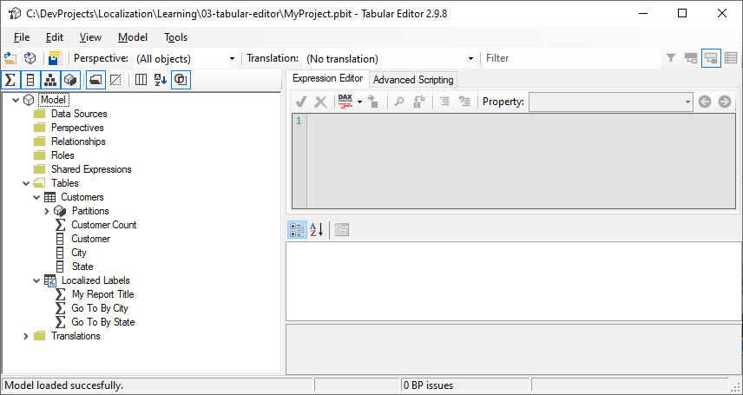
Tabular Editor
Download
https://github.com/otykier/TabularEditor/
https://github.com/otykier/TabularEditor/releases/download/2.9.8/TabularEditor.Installer.msi
Used to add localization support to PBIT file
You must use PBIT file not a PBIX file

Slide 5
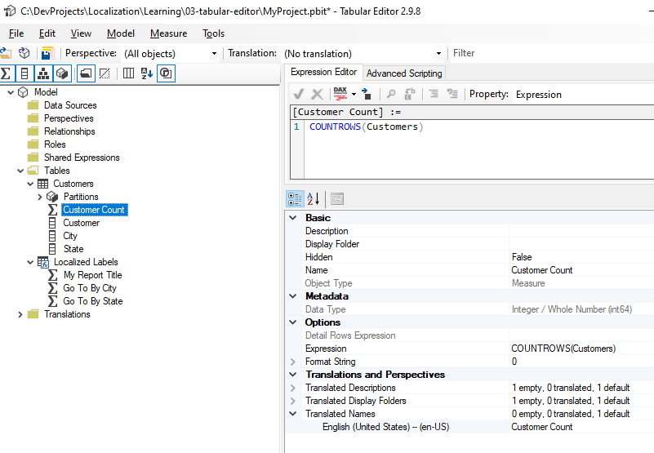
Add Localization Support for Fields

Slide 6
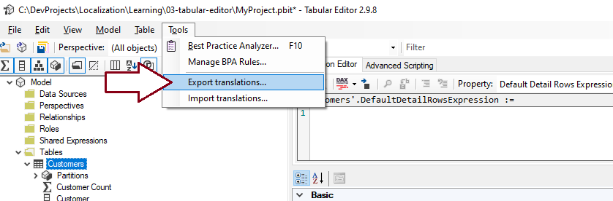
Exporting Schema Metadata for Localization

Slide 7
Agenda
Introduction to Multi-language Report Design
Programming Translations with TOM
Designing Workflows to Manage Translations
Multi-language Report Design with Translations
Embedding Reports with Specific Locales

Slide 8
Agenda
Introduction to Multi-language Report Design
Programming Translations with TOM
Designing Workflows to Manage Translations
Multi-language Report Design with Translations
Embedding Reports with Specific Locales

Slide 9
Localization Workflow
Prepare PBIX in Power BI Desktop
Create Localized Labels table
Created localized labels as measures with localizable names
Add localization support to PBIX
Requires using Tabular Editor or Tabular Object Model (TOM)
Add localized string content to PBIX using Tabular Editor
Translate content
Create Master RESX file to send out for translation
Get RESX files back from translators
Use HelperTool to merge all RESX files into default.json

Slide 10
Agenda
Introduction to Multi-language Report Design
Programming Translations with TOM
Designing Workflows to Manage Translations
Multi-language Report Design with Translations
Embedding Reports with Specific Locales

Slide 11
Using Localized Labels
Labels added to report using Stacked bar chart visual
Add localized label measure to Values data role
Visual title generated from underlying field name
Things to remember
You cannot assign literal text to visual Title property
You cannot use textboxes since they do not support localization
You cannot add literal text to button

Slide 12
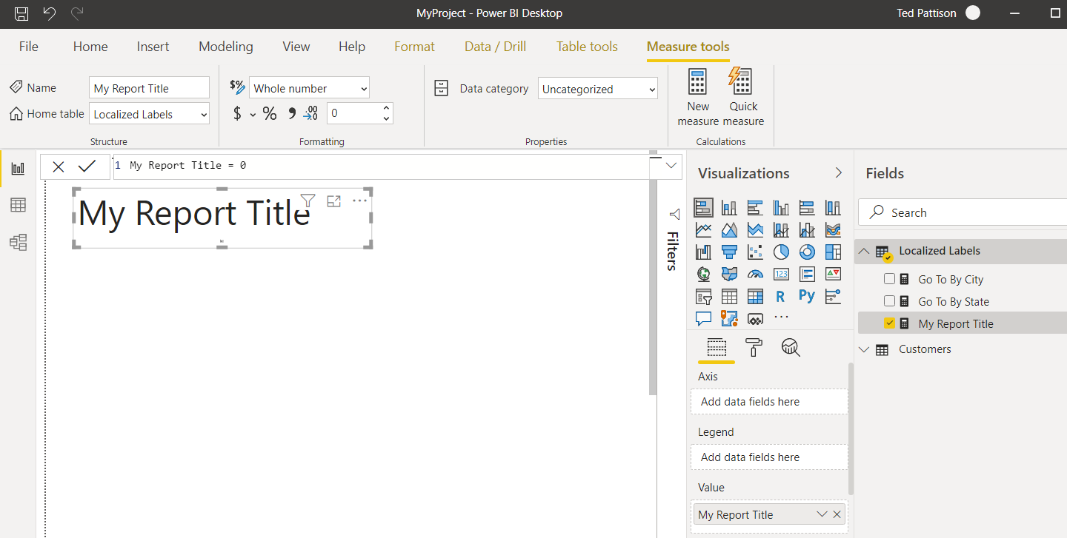
Localized Labels Table
Create a new table in data model
Add a measure for any string that needs to be localized

Slide 13
Surfacing a localized Label

Slide 14
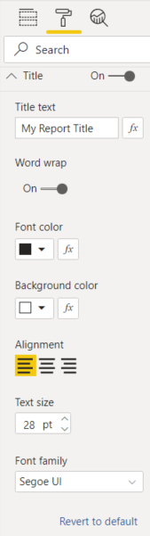
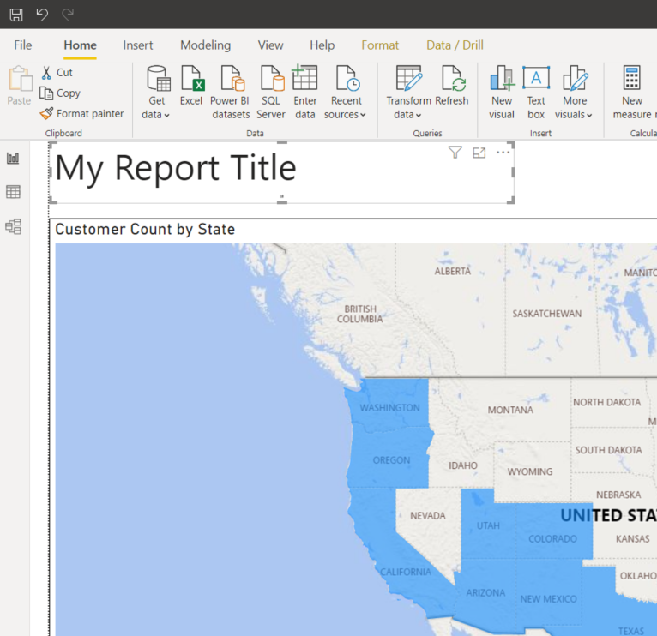
Matching the Label

Slide 15
Agenda
Introduction to Multi-language Report Design
Programming Translations with TOM
Designing Workflows to Manage Translations
Multi-language Report Design with Translations
Embedding Reports with Specific Locales

Slide 16
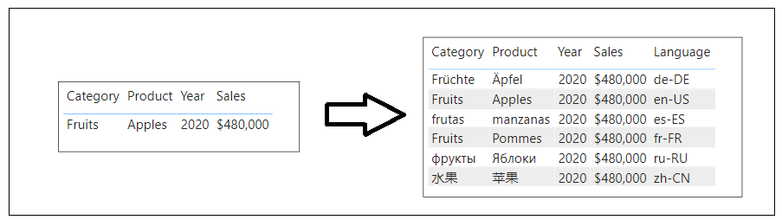

Slide 17
Take Aways for Localizing PBIX Projects
Plan from the start – very hard to do at last minute
Plan for content growth
Don’t use literal text in textboxes or button
Page tabs cannot be localized

Slide 18
Summary
Introduction to Multi-language Report Design
Programming Translations with TOM
Designing Workflows to Manage Translations
Multi-language Report Design with Translations
Embedding Reports with Specific Locales

